Slide 1
DEPARTMENT OF COMPUTER SCIENCE AND ENGINEERING CMR TECHNICAL CAMPUS 2019-2023 A MAJOR PROJECT ON INSTANT PLASMA DONOR RECIPIENT CONNECTOR WEB APPLICATION
BY–
B. SRAVAN KUMAR REDDY (197R1A05P7)
K.GANGA REDDY (197R1A05L8)
P. VIKAS (197R1A05P0)
Under the Guidance of
J.NARASIMHARAO
(Associate Professor)

Slide 2
ABSTRACT
The world is suffering from COVID-19 crisis, and we have not found any vaccine yet. But there is another scientific way from which we can help to lower the death ratio or help the COVID-19 affected person is by donating plasma from recovered patients. With no approved antiviral treatment plan for the deadly COVID-19 infection, plasma therapy is an experimental approach to treat COVID-19 positive patients and help them recover faster. The therapy is considered to be safe and promising. If a particular person is fully recovered from COVID-19, he/she is eligible to donate their plasma. In the proposed system, donors who need to donate plasma can donate by uploading COVID-19 certificate and blood bank can view donors and can raise requests to donors and the hospital can register/login and can search for the plasma, they can raise requests to blood bank and can get the plasma.

Slide 3
EXISTING SYSTEM
People have to find them physically by visiting hospitals register books and reaching out to recovered donors homes. Sometimes they will be not available at their places and will be went on work.
In this type of scenarios, diseased persons health gets more worsened. This is an expensive and will not work as effectively in emergency situations.

Slide 4
DISADVANTAGES
Tedious work
Expensive
Requires more man power
Time consuming

Slide 5
PROPOSED SYSTEM
In the proposed system, a donor who wants to donate plasma can simply upload his/her covid-19 recovered certificate and can donate plasma to the blood bank.
Blood bank after verifying donor certificate can raise a request to the donor once the donor accepts a request they can add the required amount of units they need. Hospital can send requests to blood bank who need emergency plasma to patients and collect the plasma from the blood bank.

Slide 6
ADVANTAGES
Immediate solutions
Saves time and energy
Saves money
Ease of finding

Slide 7
HARDWARE REQUIRMENTS
System : Pentium IV 2.4 GHz.
Hard Disk : 40 GB.
Floppy Drive : 1.44 Mb.
Ram : 512 Mb

Slide 8
SOFTWARE REQUIRMENTS
Operating System - Windows 10 and above
Language - Python 3.6

Slide 9
NOVELTY
People have to find them physically by visiting hospitals register books and reaching out to recovered donors homes. Sometimes they will be not available at their places and will be went on work. Blood bank after verifying donor certificate can raise a request to the donor once the donor accepts a request they can add the required amount of units they need. Hospital can send requests to blood bank who need emergency plasma to patients and collect the plasma from the blood bank.

Slide 10
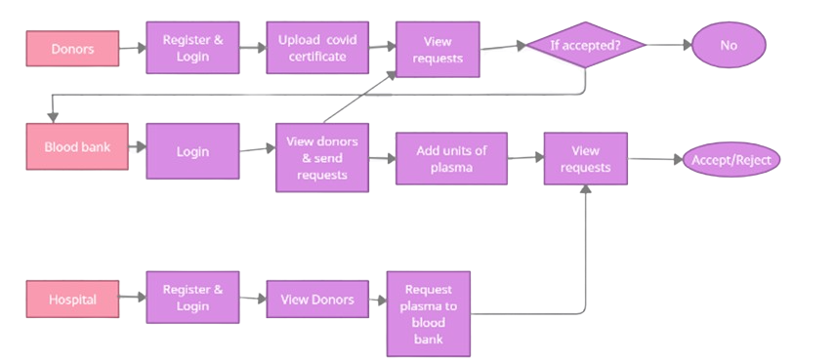
ARCHITECTURE

Slide 11
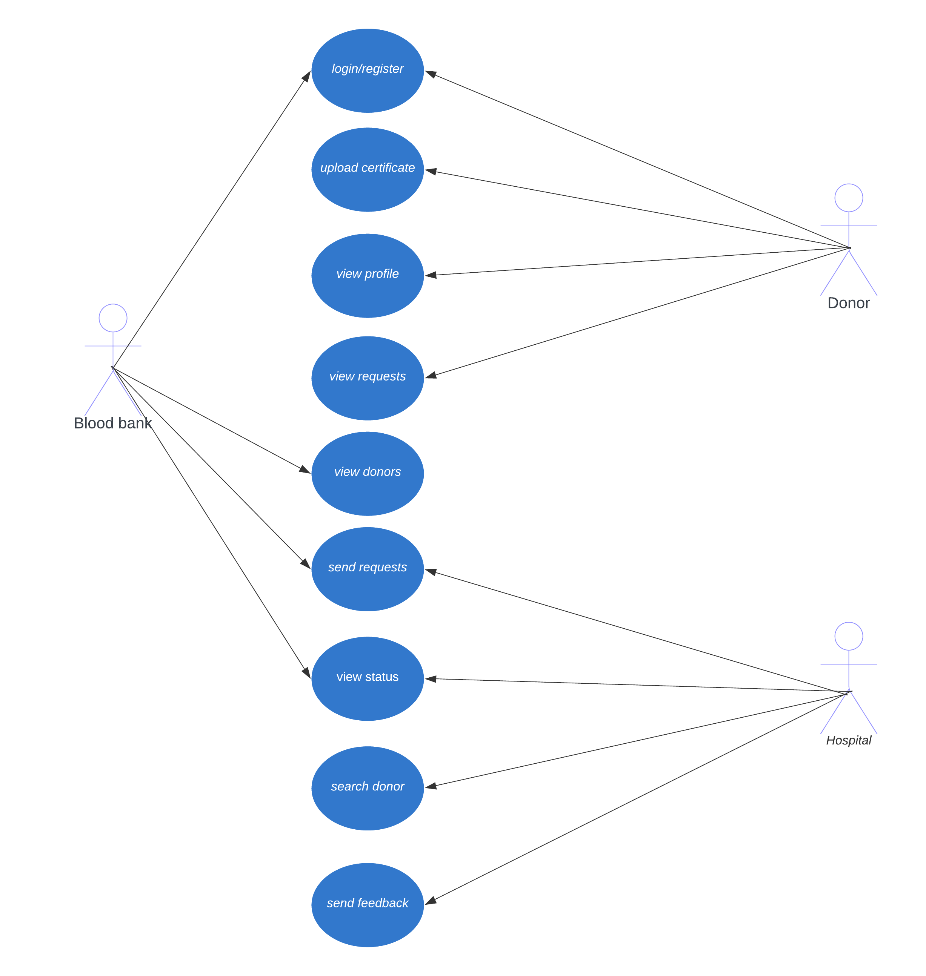
USE CASE DIAGRAM

Slide 12
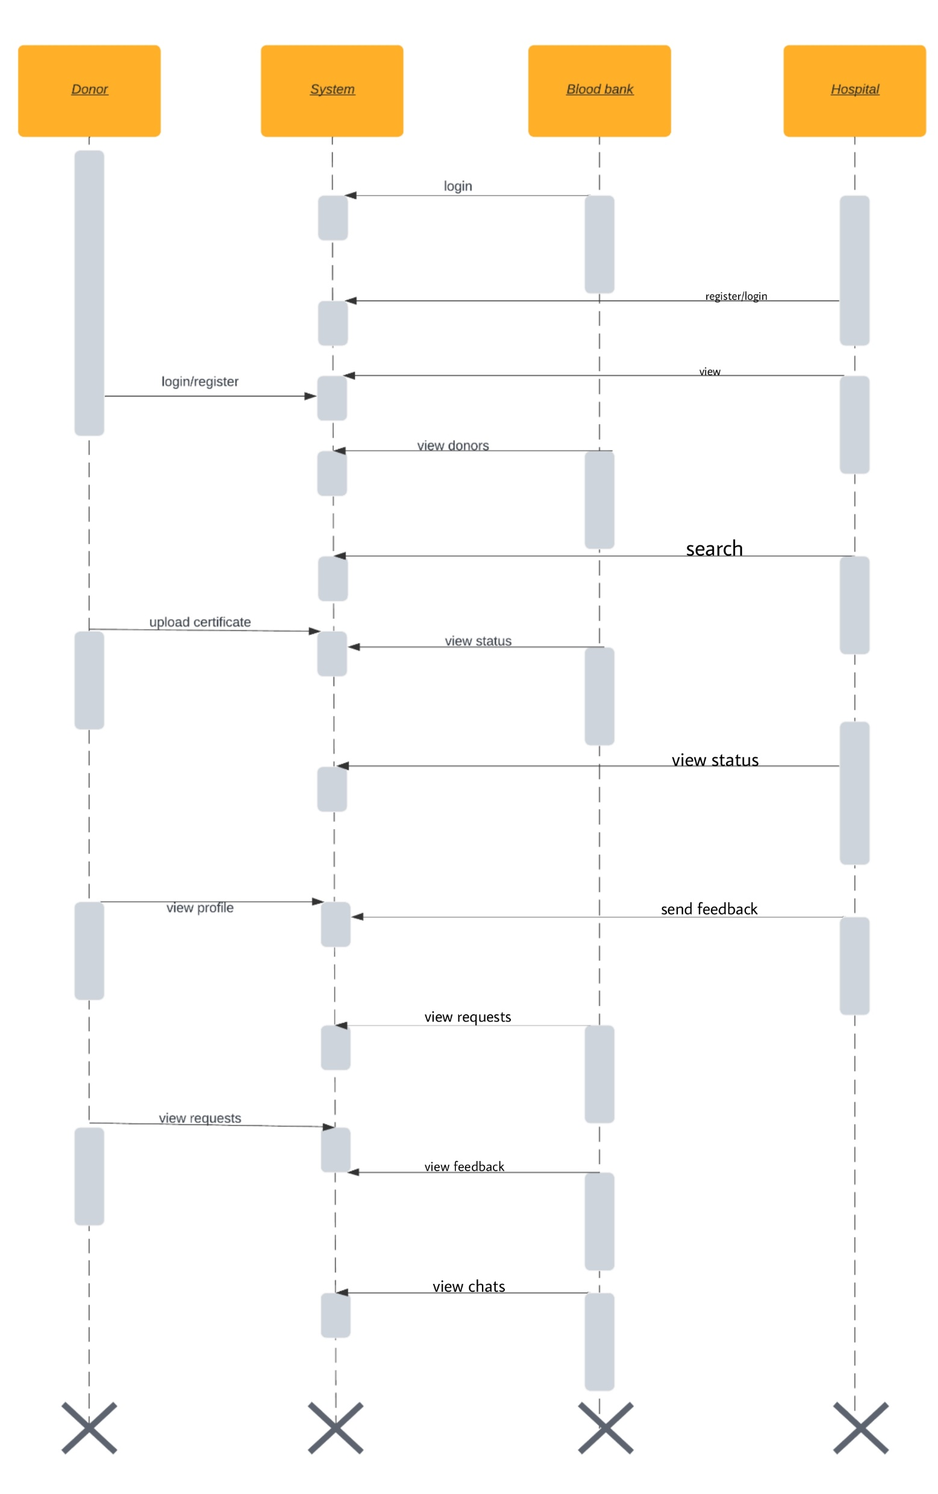
SEQUENCE DIAGRAM

Slide 13
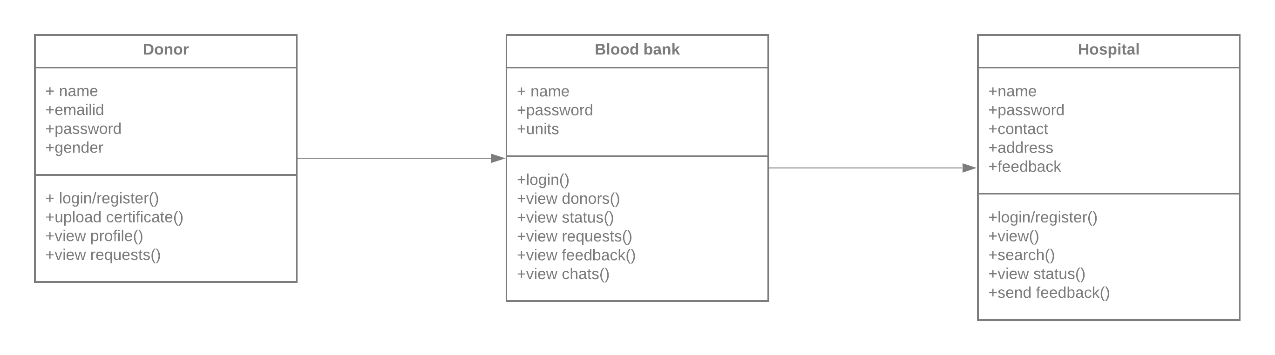
CLASS DIAGRAM

Slide 14
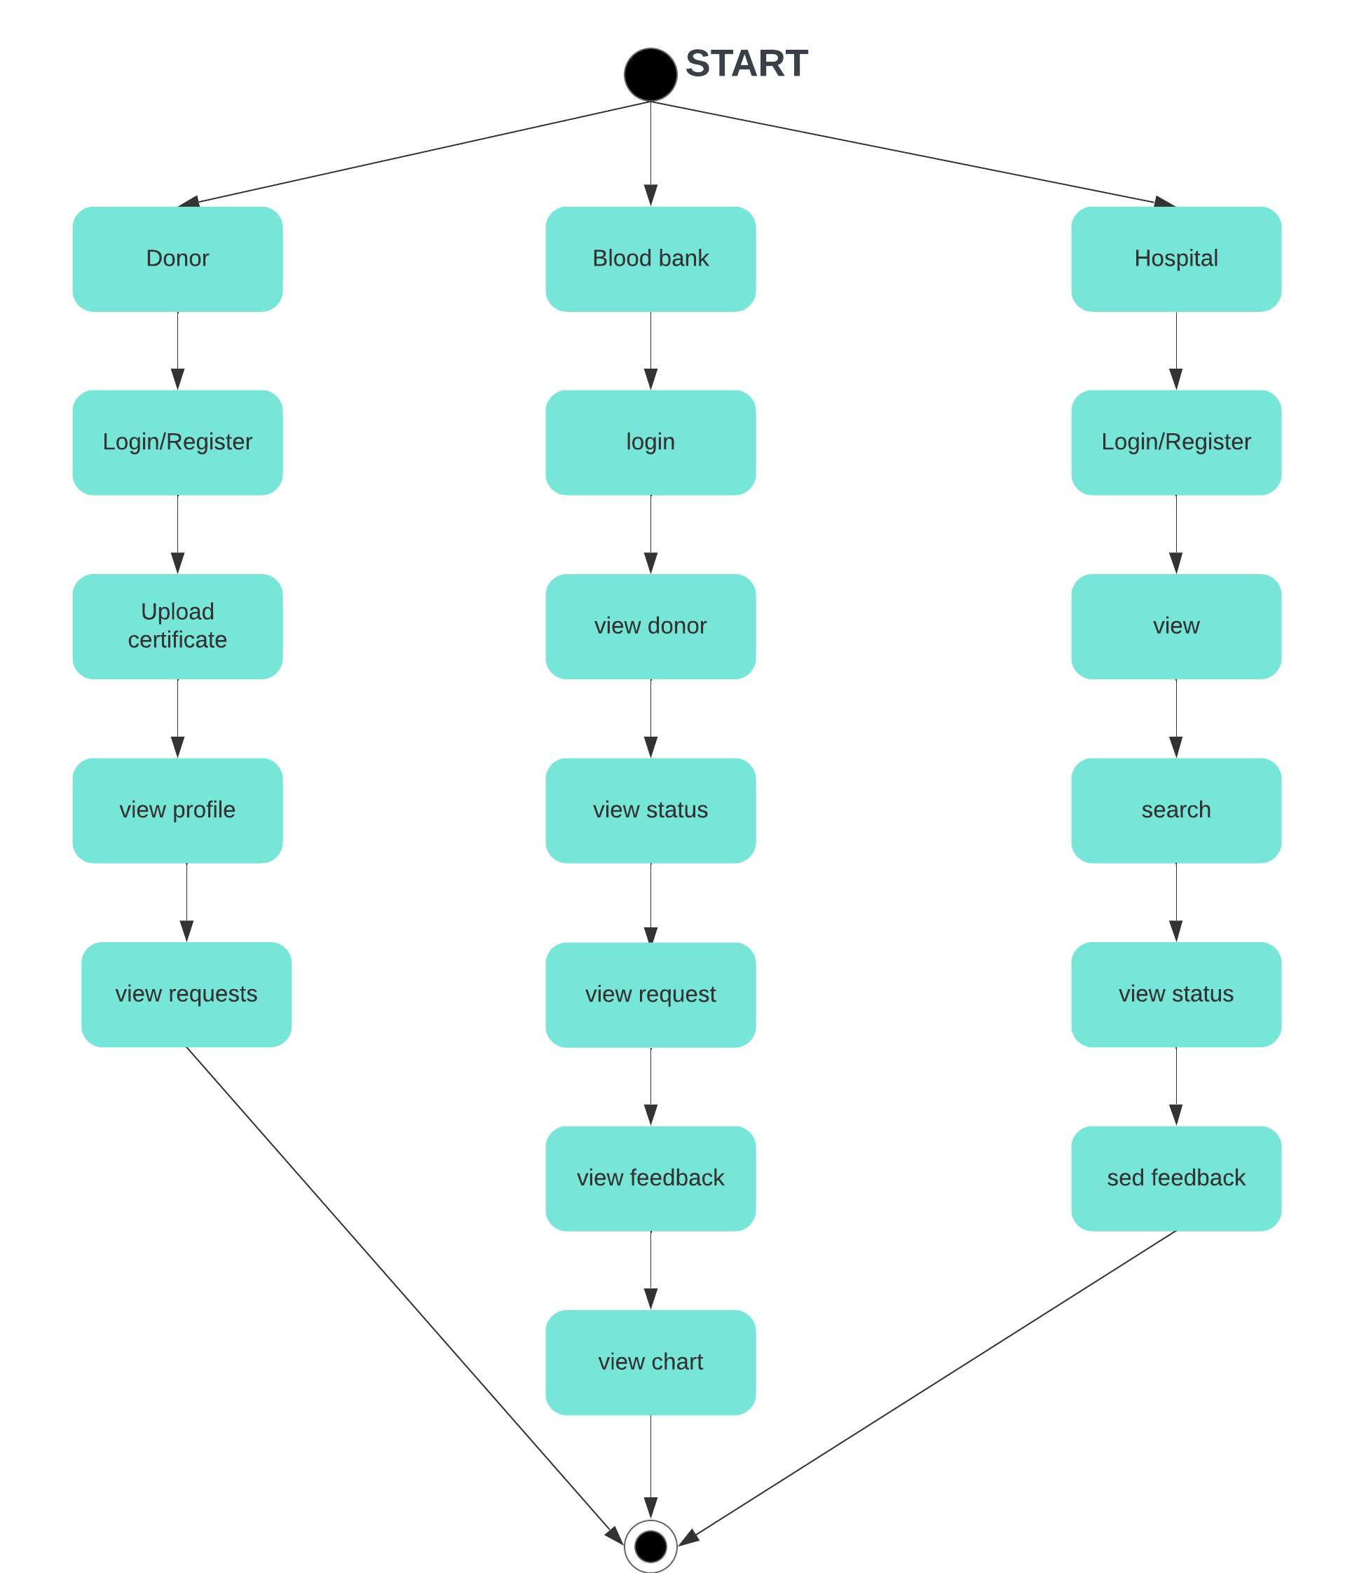
ACTIVITY DIAGRAM

Slide 15
SAMPLE CODE
ADMINLOGIN.PHP
<?php session_start();
include('includes/config.php'); if(isset($_POST['login']))
{
$email=$_POST['username'];
$password=md5($_POST['password']);
$sql ="SELECT UserName,Password FROM admin WHERE UserName=:email and Password=:password";
$query= $dbh -> prepare($sql);
$query-> bindParam(':email', $email, PDO::PARAM_STR);
$query-> bindParam(':password', $password, PDO::PARAM_STR);
$query-> execute();
$results=$query->fetchAll(PDO::FETCH_OBJ); if($query->rowCount() > 0)
{
$_SESSION['alogin']=$_POST['username'];
echo "<script type='text/javascript'> document.location = 'change-password.php';
</script>";
} else{
echo "<script>alert('Invalid Details');</script>";
}
}

Slide 16
DASHBOARD.PHP
<?php
$sql ="SELECT id from tblplasmagroup ";
$query = $dbh -> prepare($sql);
$query->execute();
$results=$query->fetchAll(PDO::FETCH_OBJ);
$bg=$query->rowCount();
?>
$sql1 ="SELECT id from tblplasmadonars ";
$query1 = $dbh -> prepare($sql1);;
$query1->execute();
$results1=$query1->fetchAll(PDO::FETCH_OBJ);
$regbd=$query1->rowCount();
?>
$sql6 ="SELECT id from tblcontactusquery ";
$query6 = $dbh -> prepare($sql6);;
$query6->execute();
$results6=$query6->fetchAll(PDO::FETCH_OBJ);
$query=$query6->rowCount();
?>

Slide 17
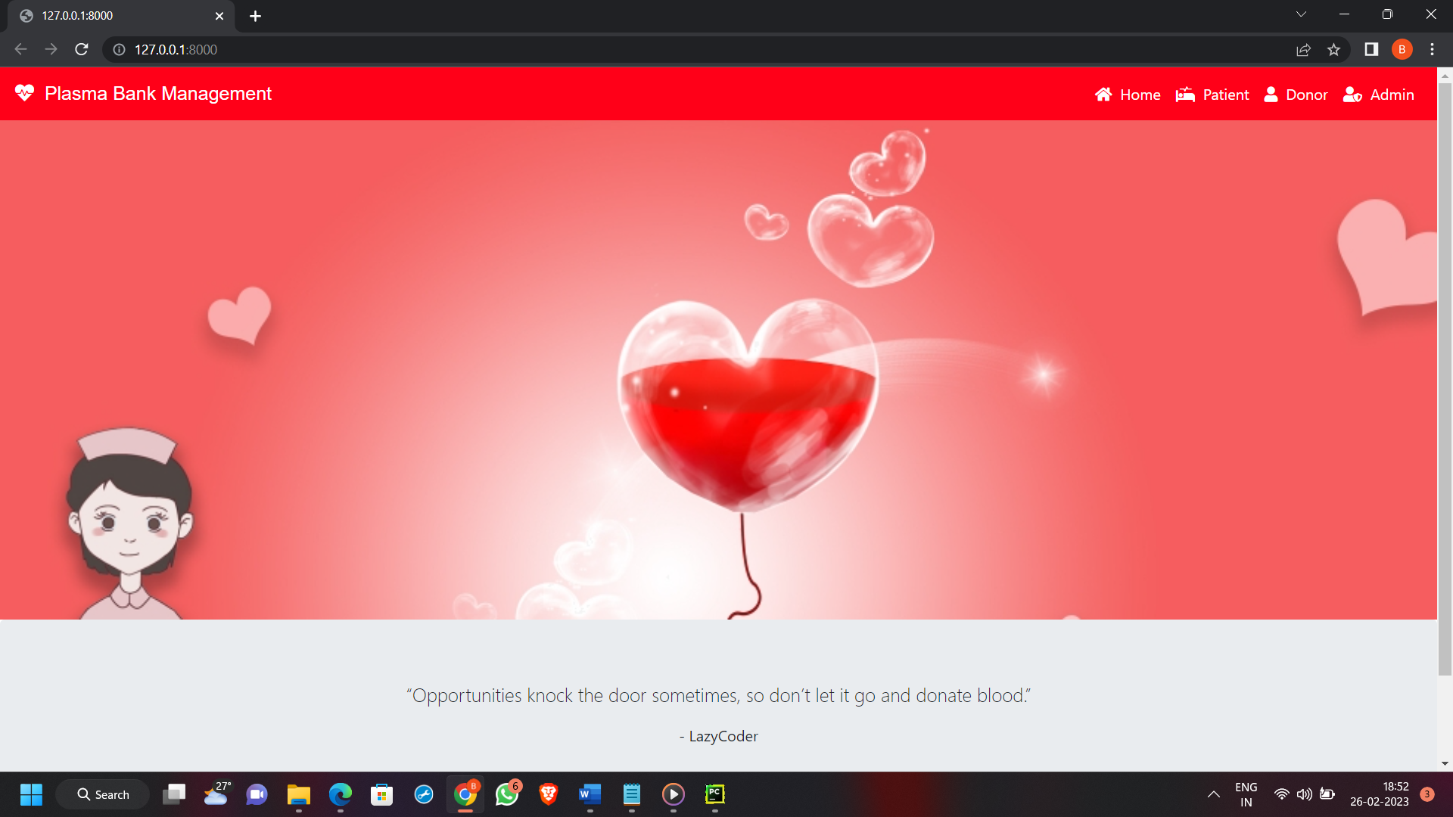
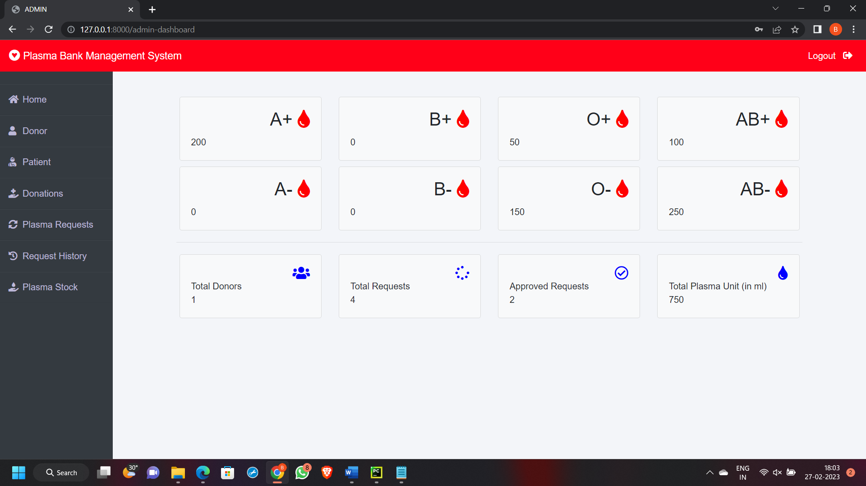
RESULTS
GUI OF PROJECT
ADMIN DASHBOARD

Slide 18
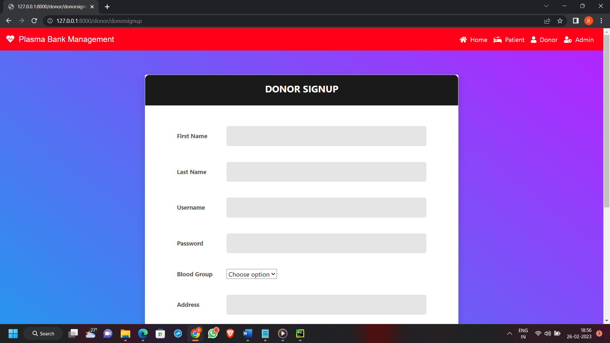
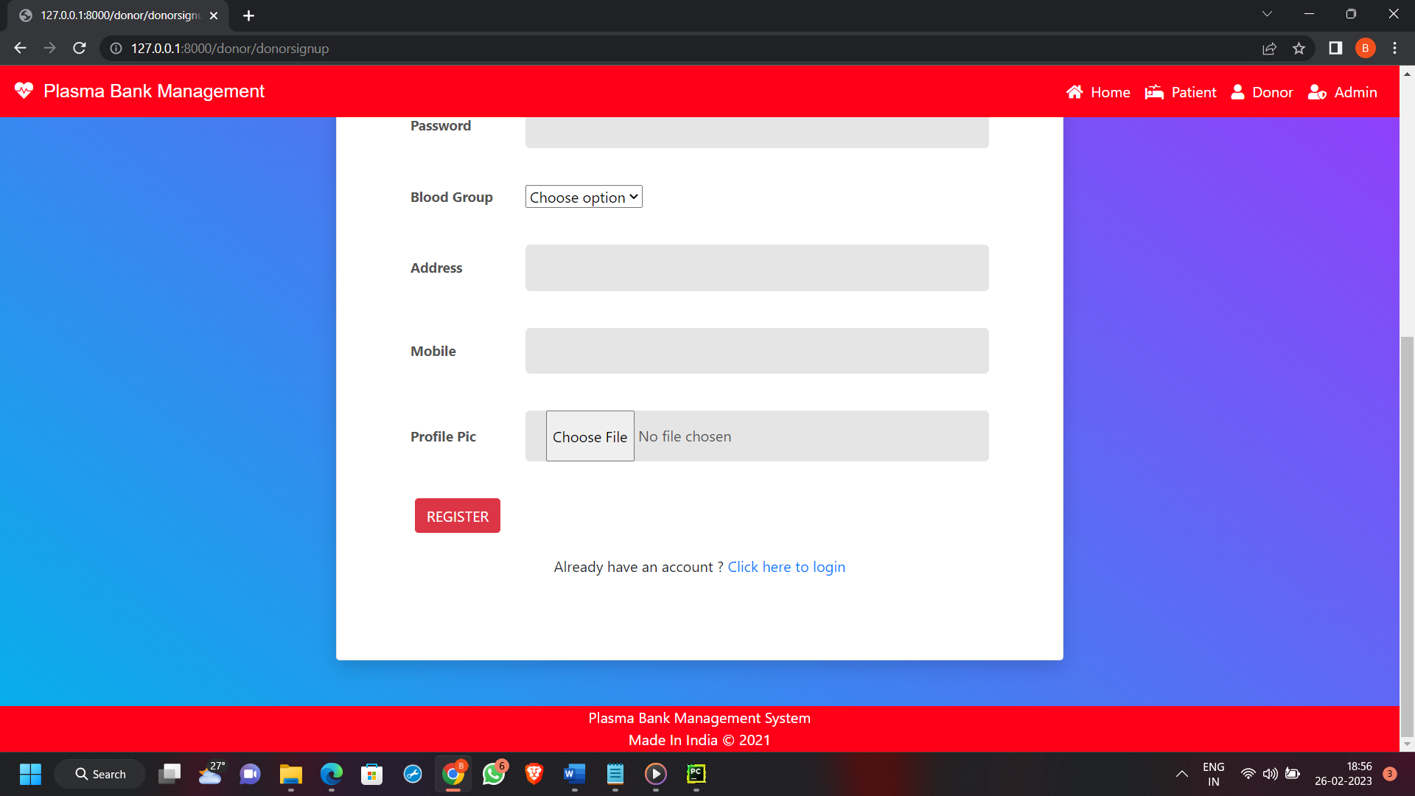
REGISTER PAGE

Slide 19
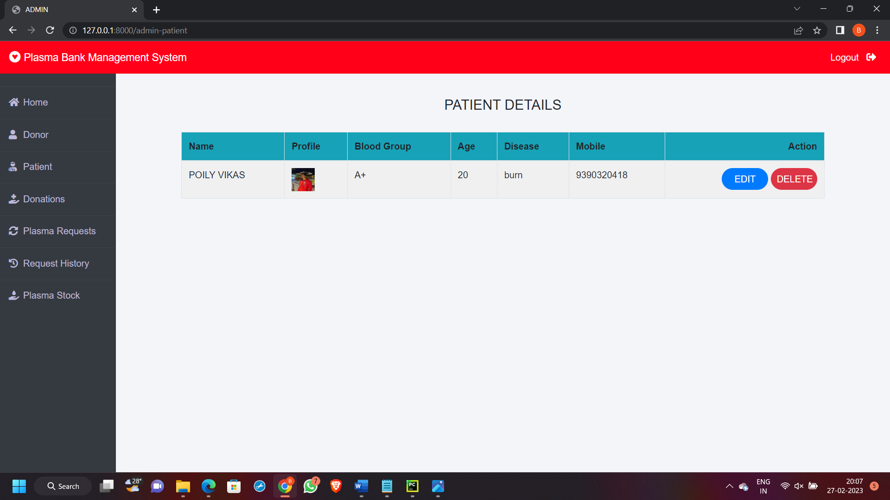
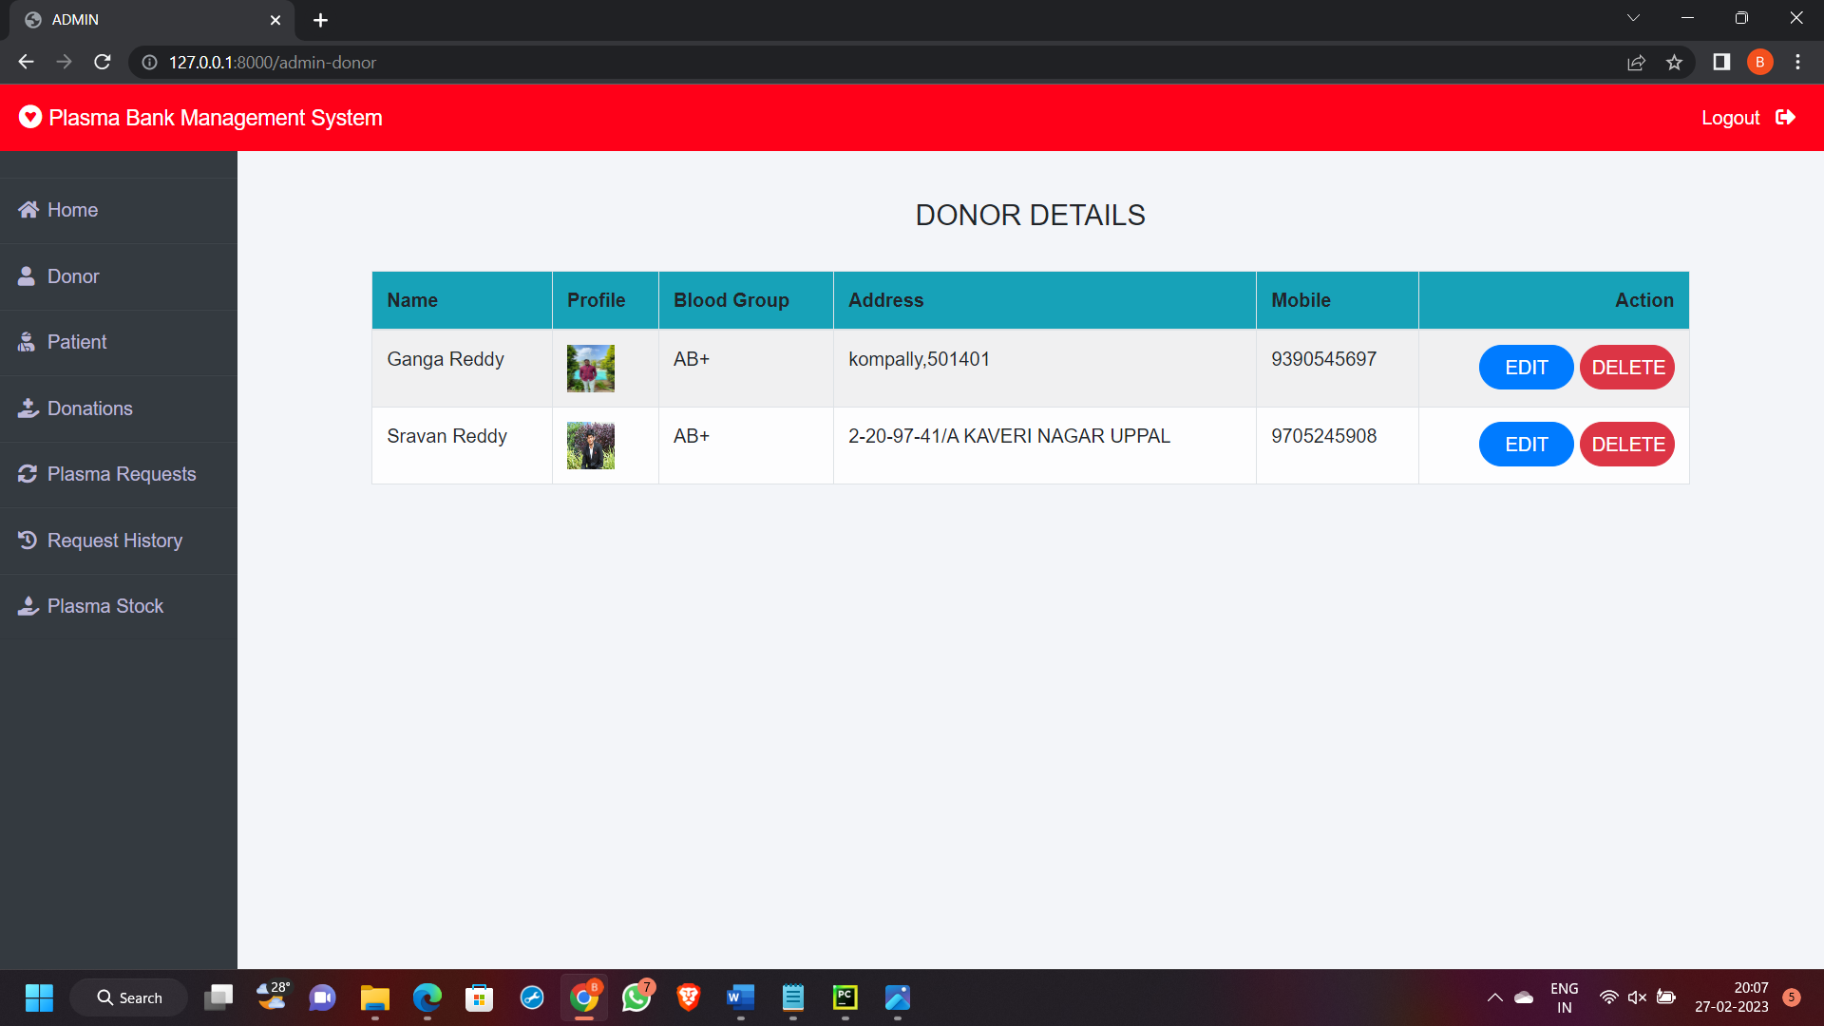
PATIENT DETAILS
DONOR DETAILS

Slide 20
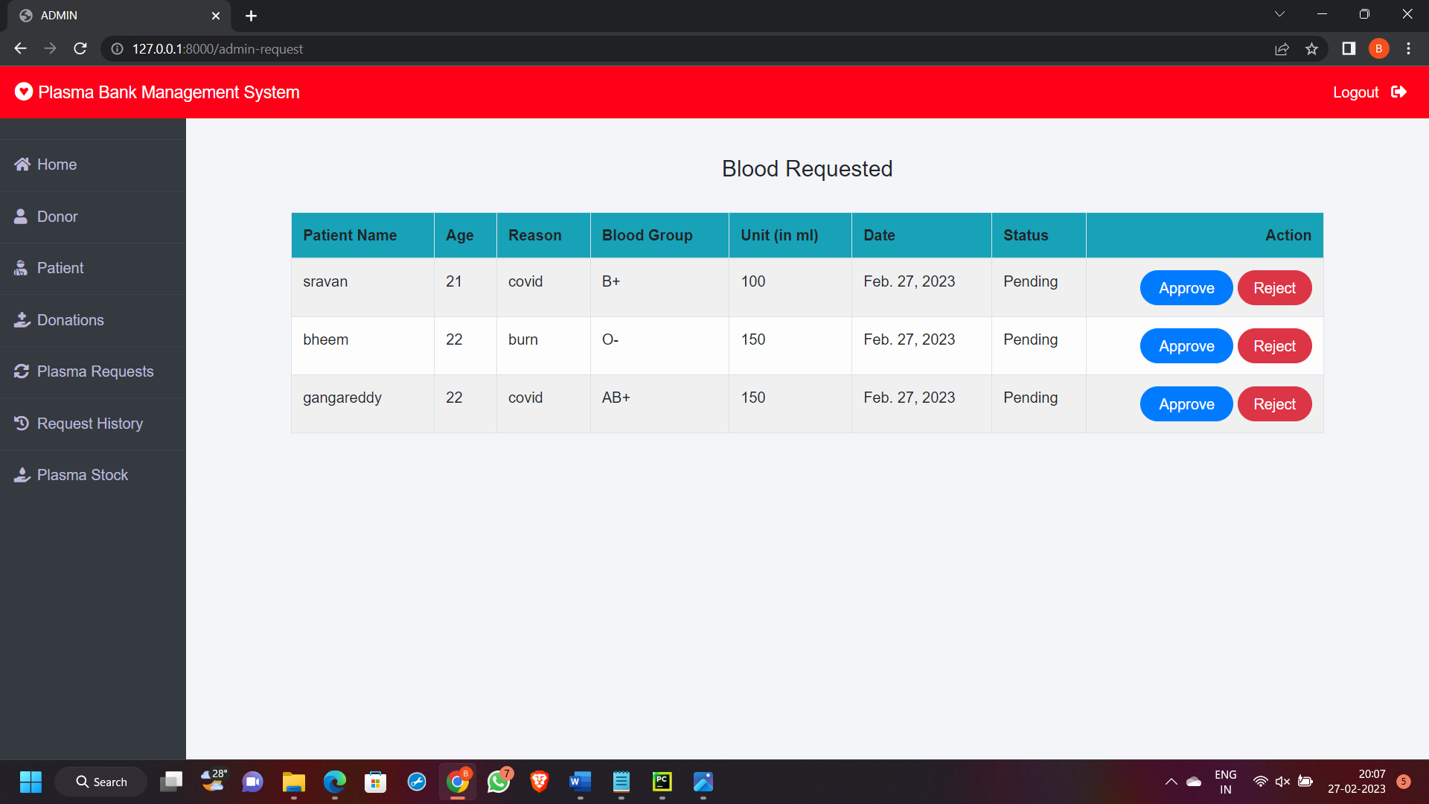
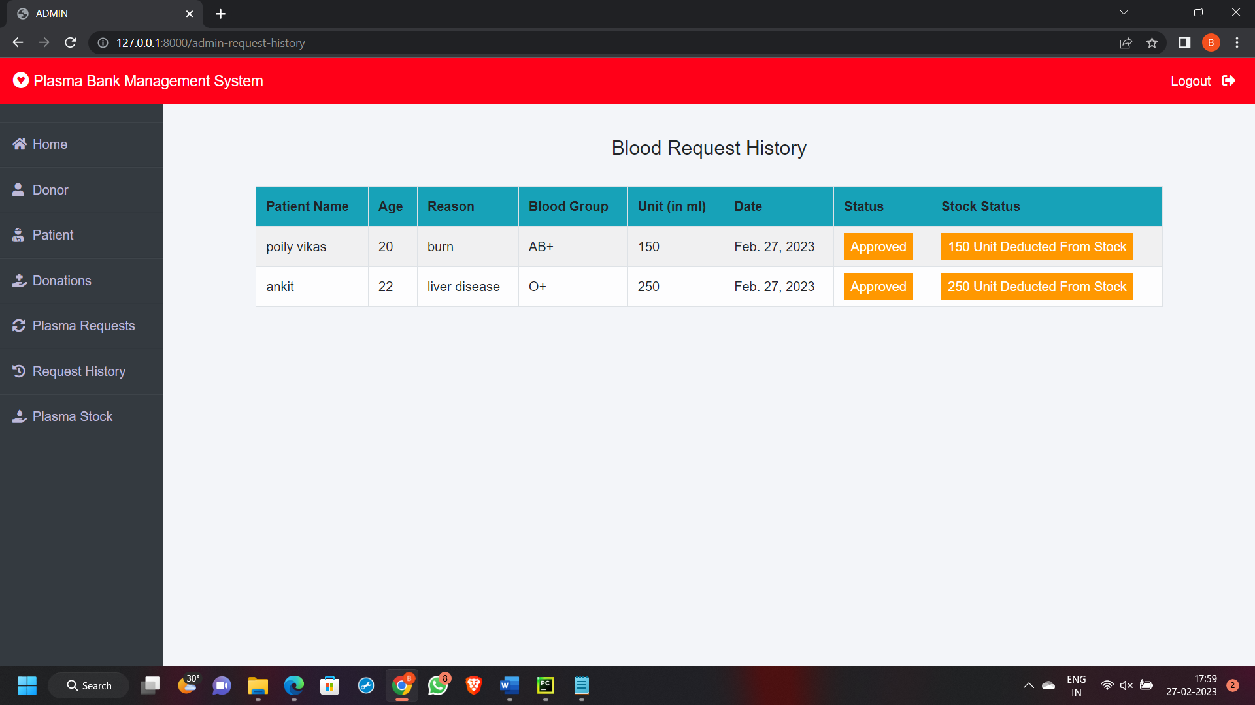
BLOOD REQUEST
BLOOD REQUEST HISTORY

Slide 21
CONCLUSION
Plasma is the yellow liquid part of the blood that contains antibodies, Antibodies are proteins made by the body in response to infection. People who have fully recovered from COVID-19 for atleast two weeks are encouraged to consider donating plasma, Which may help to save the lives of other patients. Because you fought the infection, your plasma now contains COVID-19 antibodies. These antibodies provided one way for your immune system to fight the virus when you were sick, so your plasma may be able to be used to help others fight off the disease. Individuals must have a prior diagnosis of COVID-19 documented by a laboratory test and meet other donor qualifications. Individuals must have complete resolution of symptoms for atleast 14 days prior to donation. A negative lab test for active COVID-19 disease is not necessary to qualify for donation.

Slide 22
FUTURE ENHACEMENT
In future this type of process is very helpful and useful to patients who need emergency plasma. At present the world is suffering from the COVID-19 crisis, and we haven’t found any vaccine yet. So, this type of process is useful in future also. As there was a little number of contact person’sinformation given,some people may facedifficulty in getting plasma fast. So We like to gather more information regarding the contact persons in other cities as well as villages and will provide much more services forthe people and help everyone with humanity.

Slide 23
REFERENCES
PHP MySQL Website Programming: Problem - Design – Solution byChris Lea, Mike Buzzard, Dilip Thomas , Jessey White-Cinis
Beginning PHP5, Apache, and MySQL Web Development (Programmer to Programmer) by Elizabeth Naramore
MySQL/PHP Database Applications, 2nd Edition by Brad Bulger
How to Do Everything with PHP and MySQL by Vikram Vaswani
Auby, J.-F. (1994): “Les eaux minérales”, Presses Universitaires de France, collection Que sais-je?
"Convalescent plasma for the treatment of COVID-19: A review." Infectious Diseases and Therapy, 2020. 9.
"Convalescent plasma therapy for COVID-19: A promising therapeutic option." Journal of Clinical Medicine, 2020. 10.
"Convalescent plasma therapy for COVID-19: A critical review of the evidence." Frontiers in Medicine, 2021.

Slide 24
GITHUB LINK
https://github.com/sravanreddy9705/INSTANT-PLASMA-DONOR-RECIPIENT-CONNECTOR-WEB-APPLICATION.git

Slide 25
THANK YOU

